Slide 1

LOKSABHA ELECTION RESULTS TRENDS
PROJECT ON

Slide 2

INTRODUCTION
IN THIS PROJECT WE TAKE THE DATA OF LOKSABHA ELECTION AND ANALYSE THEM USING PYTHO
SOURCE-INDIAN ELECTION COMMISION WEBSITE AND INDIA VOTES WEBSITE

Slide 3

PROJECT INSIDES
WE ARE GOING TO SHOW ELECTION RESULTS INTO THREE PARTS
OVERALL ANALYSIS
PARTYWISE ANALYSIS
REIGION WISE ANALYSIS
IN THIS PROJECT WE DIVIDED PARTIES INTO THREE PARTS.
BJP(BHARTIYA JANTA PARTY)
INC(INDIAN NATIONAL CONGRESS)
OTHERS(ALL OTHER NATIONAL AND REIGIONAL PARTIES)

Slide 4

OVERALL TRENDS
IN THIS SECTION WE COVER THE ELECTION RESULT FROM 1952 TO 2019

Slide 5
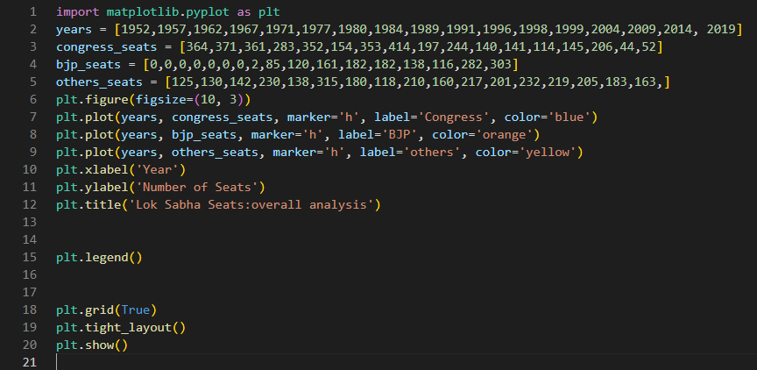

Slide 6
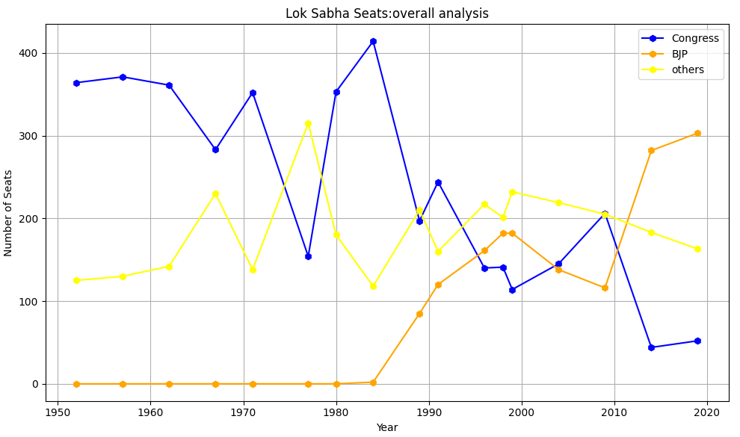

Slide 7
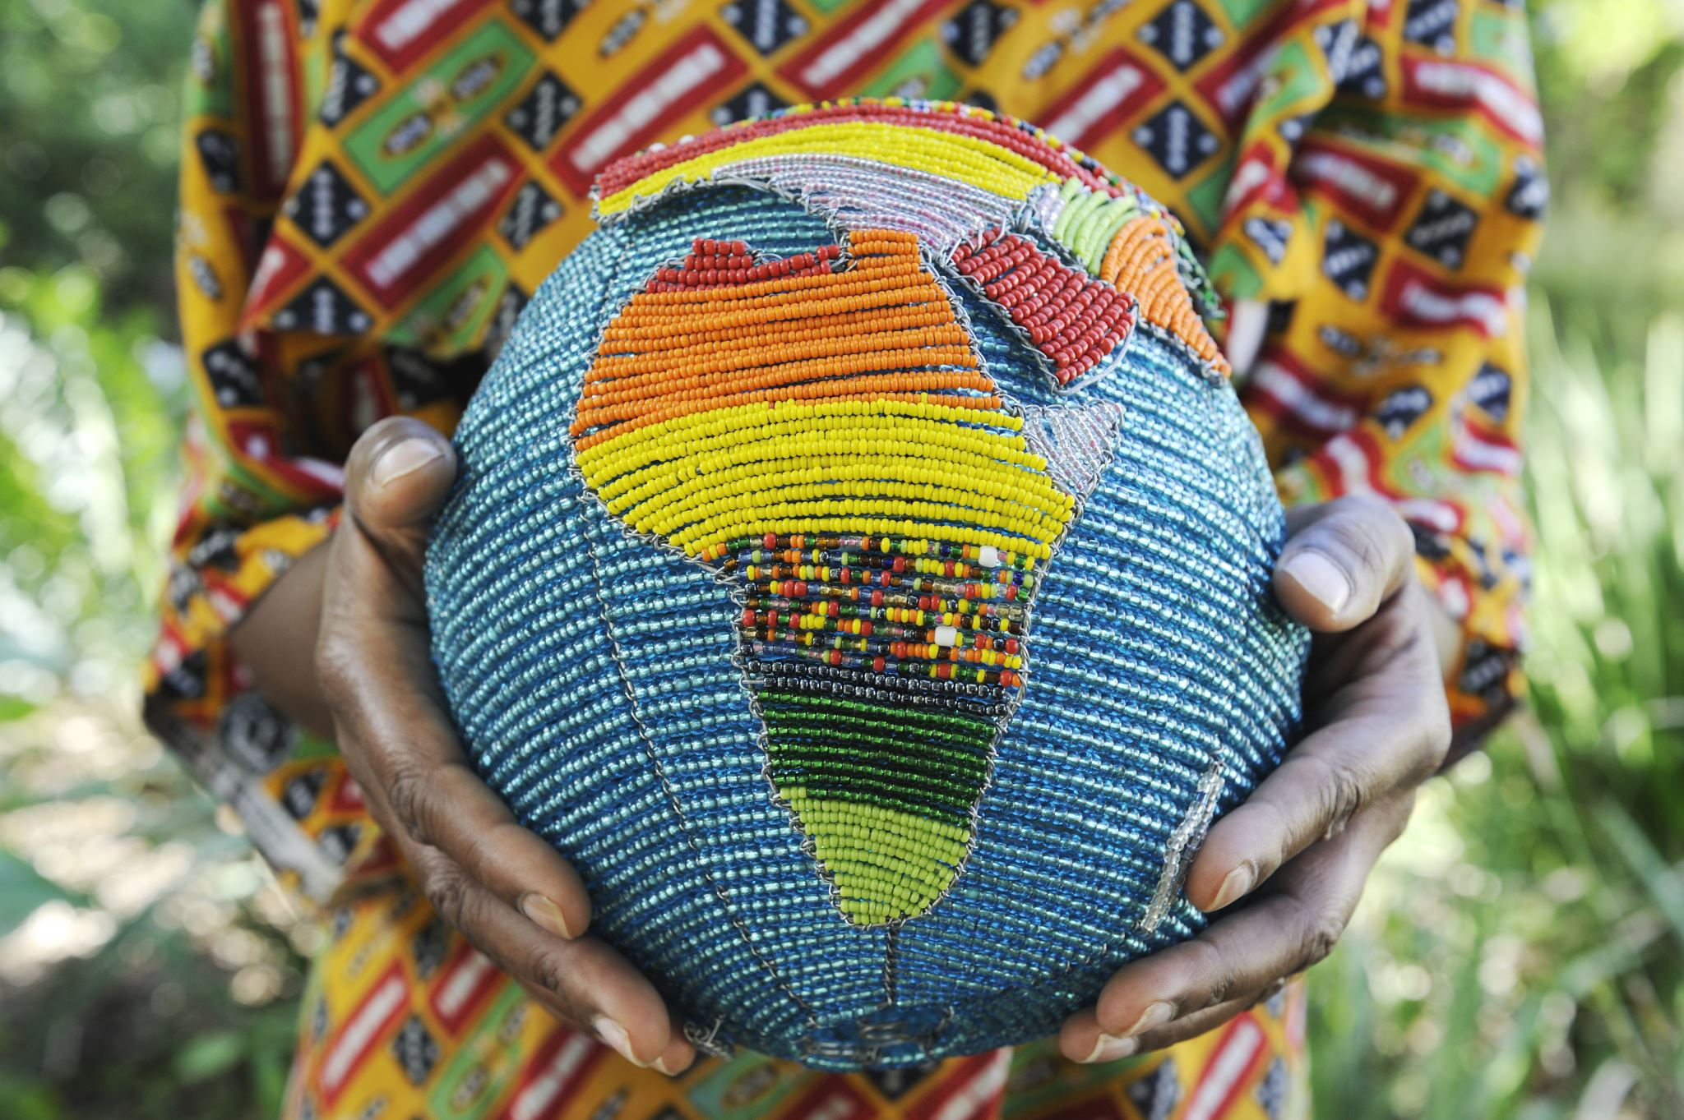
PARTYWISE TRENDS
IN THIS WE TAKE DATA OF LOKSABHA RESULTS FROM 1984 TO 2019
IN THIS WE TAKE TWO PARTY AS PREVIOUSLY DESCRIBED
BJP (BHARTIYA JANTA PARTY)
2.INC (INDIAN NATIONAL CONGRESS)

Slide 8
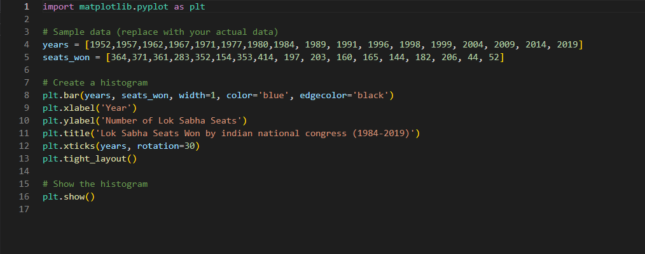

Slide 9
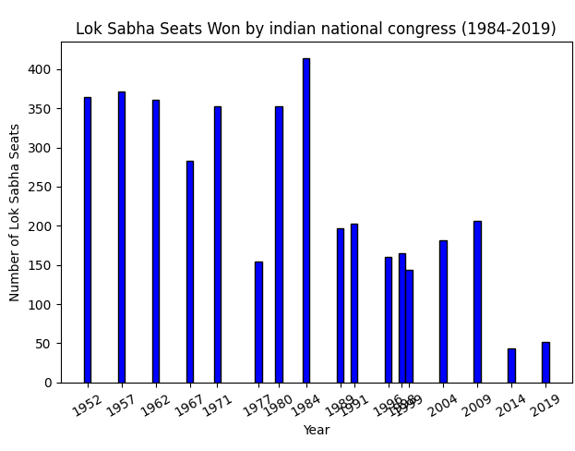

Slide 10

2.BJP

Slide 11
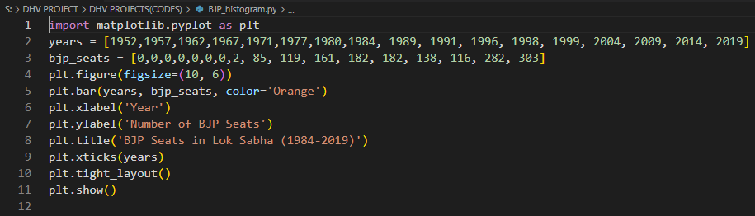

Slide 12
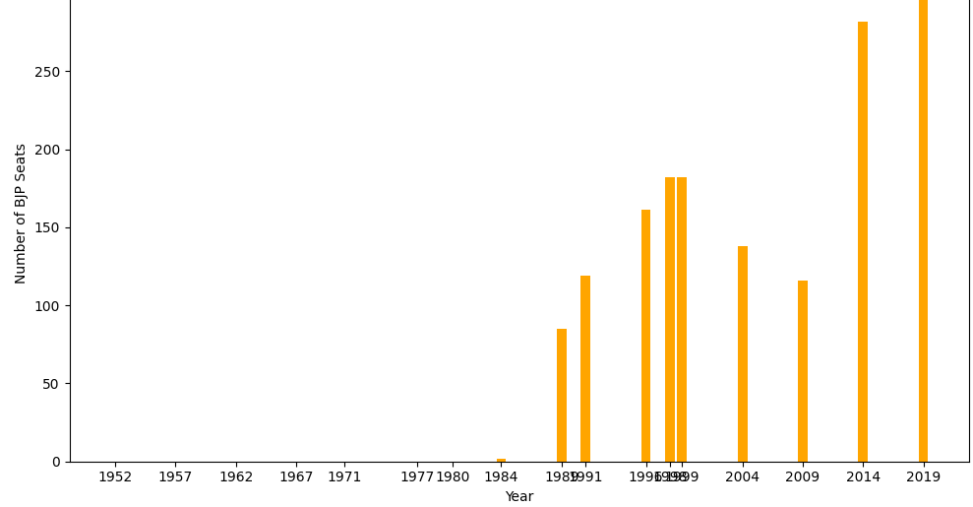

Slide 13

REIGION WISE TRNDS
NOW WE GOING DEEP INSIDE THIS AND WE DIVIDED COUNTRY INTO MULTIPLE REGIONS(COMBINING TWO OR MORE STATES)
WE DIVIDED COUNTRY INTO FIVE REIGIONS
NORTHERN INDIA
MIDDLE INDIA
SOUTHERN INDIA
WESTERN INDIA
NORTHEASTERN INDIA

Slide 14

NORTHERN INDIA
UTTAR PRADESH ,HARYANA ,PUNJAB,DELHI,HIMANCHAL PRADESH ,UTTRAKHAND,JAMMU AND AND KASHMIR(LADDAKH INCLUDED)

Slide 15
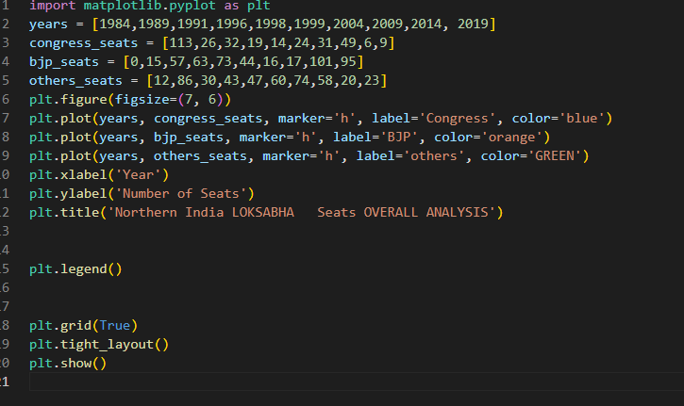

Slide 16
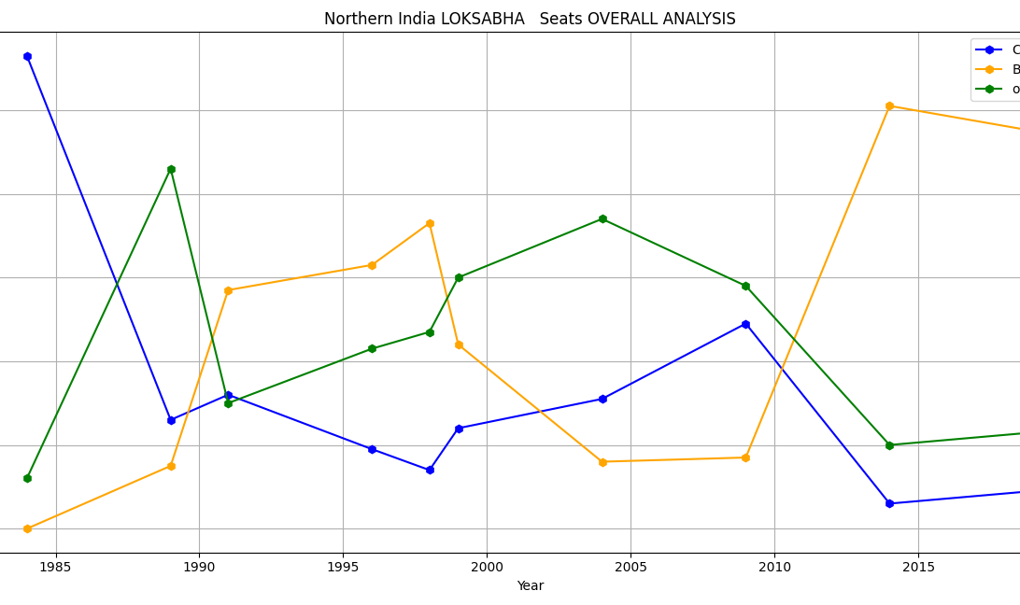

Slide 17

MIDDLE INDIA STATES (MADHYA PRADESH, MAHARASHTRA , GUJRAT, RAJASTHAN, CHATTISHGARH)

Slide 18
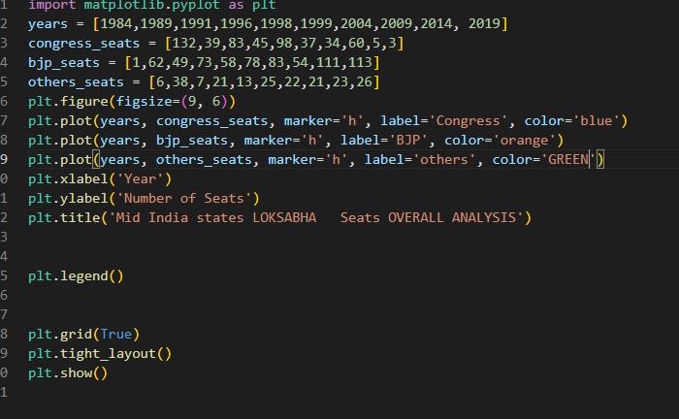

Slide 19
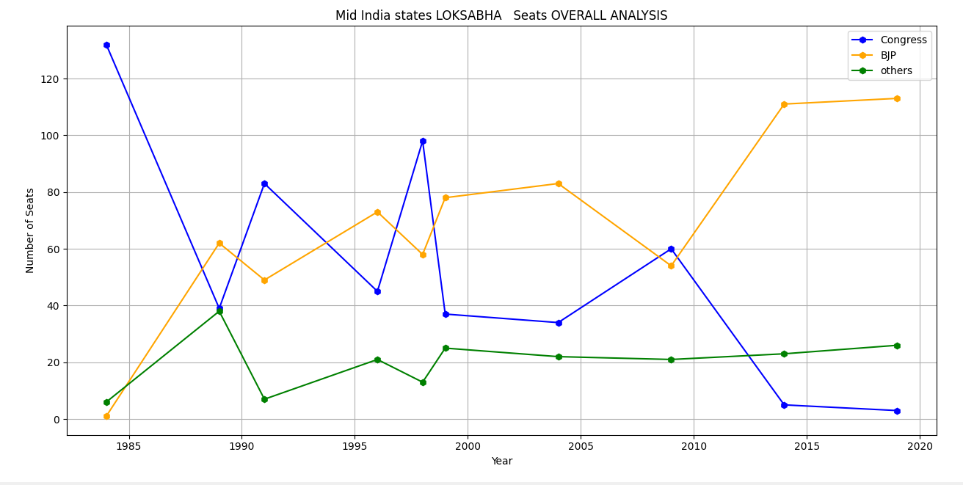

Slide 20

EASTERN INDIA
BIHAR,JHARKHAND, WEST BENGAL,ODISHA

Slide 21
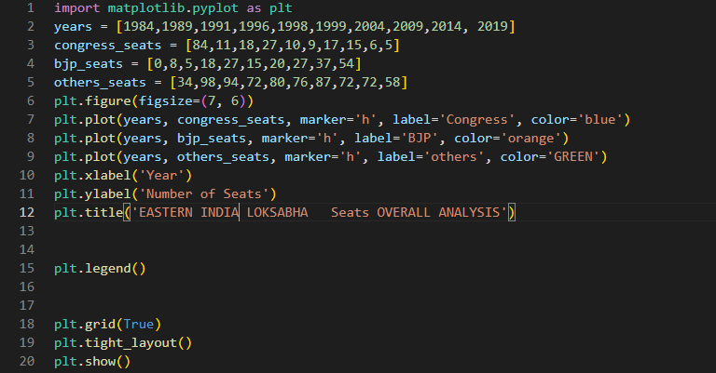

Slide 22
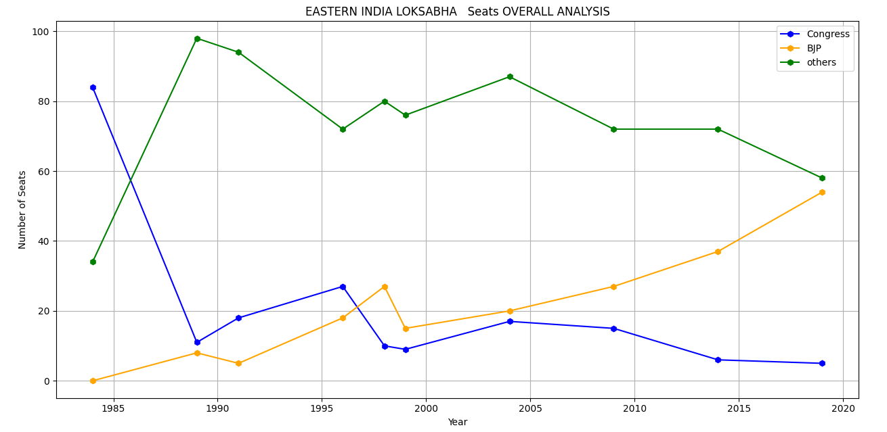

Slide 23
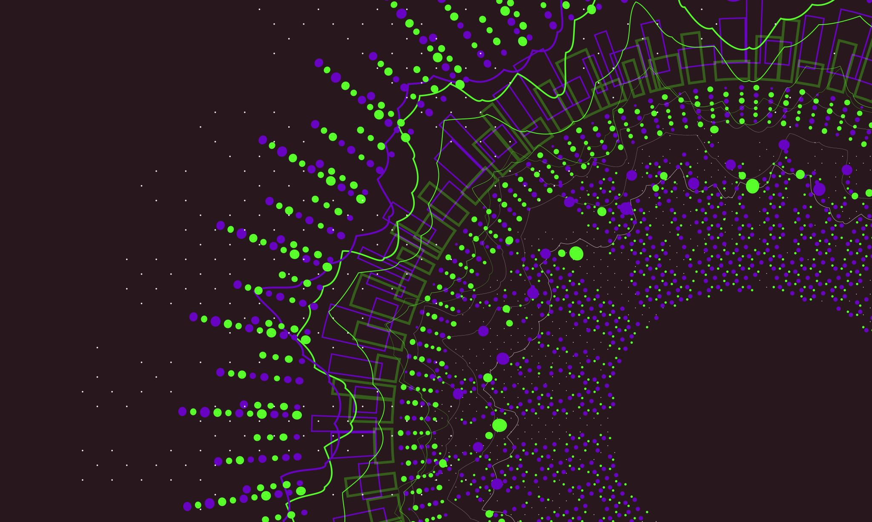
SOUTH INDIA
ANDHRA PRADESH ,TELANGANA ,TAMILNADU ,GOA ,KARNATKA,KERALA

Slide 24
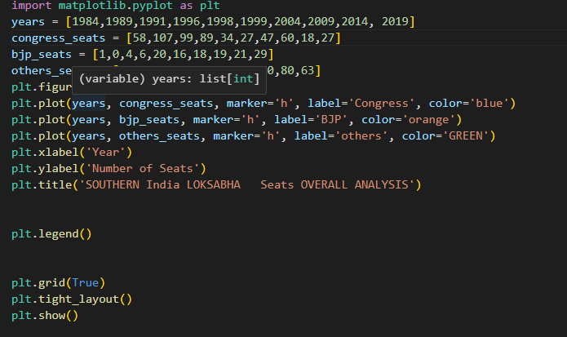

Slide 25
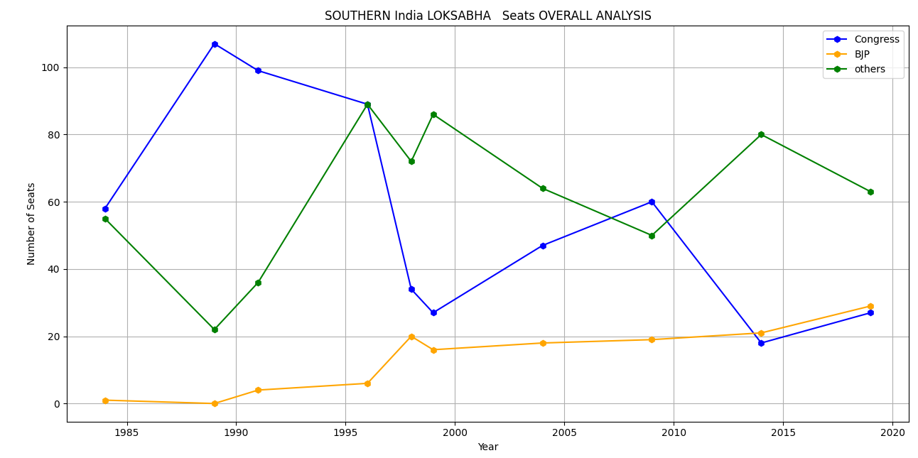

Slide 26
NORTHEAST INDIA

Slide 27
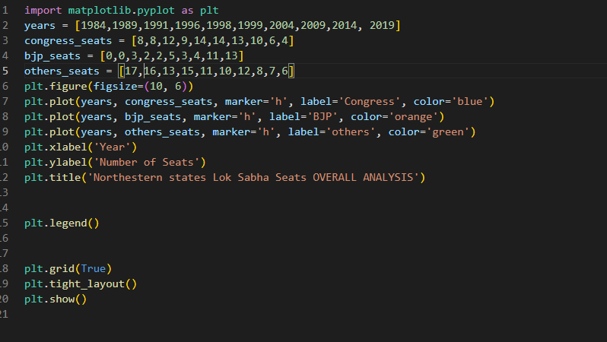

Slide 28
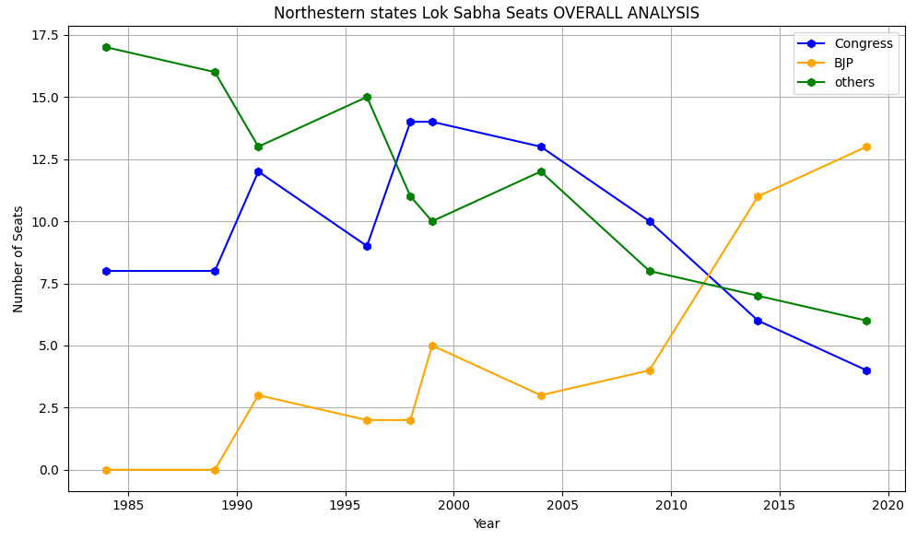

Slide 29

SUBMITTED BY - HARSHIT OJHA THANKYOU

